Slide 1
Welcome To Start Elementary
Start Small, Dream Big:
Owls Soaring Toward Excellence

Slide 2
Celebrations
New faculty
Caitlyn Arnold (K-3 Science)
Michaela Humble (3-4 ELA)
Jenna Payne (6-8 ELA Resident)
Literacy Achievement
Campus improvements
School Resource Officer

Slide 3
School Wide Expectations
Only Positive Attitudes Allowed
Work and Move Quietly
Lets Keep Hands, Feet and Objects to Oneself
Show Respect to Everyone at ALL Times

Slide 4
Morning Arrival
Please use the designated car drop off area in the rear of the school by the new gym. No child should be dropped off in front of the school. Car drop off begins at 7:15 and ends at 7:35.
Breakfast is served from 7:15-7:30 in the cafeteria. Students who are not eating breakfast go directly to the auditorium. Students will also have the opportunity to eat grab-and-go breakfast once in the classroom.

Slide 5
Afternoon Dismissal
Bus students will be dismissed at 3:10.
Please do not check students out before 3:10. This affects total instructional minutes required by the state for promotion to the next grade.
Students should not be checked out after 2:30 p.m. If a child has an appointment please check them out before this time.
Afternoon car/bus changes cannot be made after 2:30 p.m.
Parents/guardians must be physically present in the office to check students out.

Slide 6
Attendance
Parent contact made on 3rd day, 5th day, and 10th day missed
After 10 days unexcused absences the student is considered truant and referred to the truancy officer.

Slide 7
Dress Code Highlights
Shorts, shirts, and dresses may be worn in all grades and must reach at least two inches above the knee.
Clothing with holes, rips, or tears may be worn if skin is not exposed.

Slide 8
Dress Code Highlights
Leggings, jeggings, sliders, or similar apparel may only be worn under a regular dress or skirt of appropriate length.
Sunglasses, hats, bandanas or caps shall not be allowed at school. Hoods shall not be worn inside a building on a school campus.

Slide 9
Bus Drivers and routes
 | Bus # 6 | Bus # 25 | Bus # 83 | Bus # 7 | Bus # 10 | Bus # 72
 | Larry Bennett | Cheryl Walker | Kirby McCarty | Donna Head | Freddy Sapp | Judy Smith
 | Green St. | Scales Rd. | Overland Stage | McClanahan Rd. | Tupelo Dr. | Geneta Dr.
 | Hwy 80 from | Adcock Rd. | Mason Rd. | Hwy 133 | Girard Rd. | Boykin Rd.
 | Charleston | Norman Rd. | Sullivan Loop | Hulen Allen Rd. | Sunset Ln. | Inusrance Rd.
 | Russell Sage | Plum Rd. | Frost Rd. | Magnolia Dr. | Lord Rd. | Lewis Rd.
 | Russell Rd. | Davis Lake Rd. | Robinson Rd. | S. Ridge Lake Loop | Del Rio Rd. | Cabuck Ln.
 | Charleston Dr. | Conner Rd. | Cox Rd. | Lafouche Ln. | Webb Hill Rd. | Old River Rd.
 | Haynes Rd. | Bayou Rd. | Bailey Rd. | Charleston Dr. | Fred Mason Rd.
 | Grays Trail | Templeton Loop | Comeaux Rd. | Jinkins Rd. | Galey Rd
 | Hogan Dr. | Hwy 80 | Cartlidge Rd. | Henry Rd. | Lake View Dr.
 | crew lake loop | Collins Rd. |  | Simmons Rd. | Charleston Dr.
 | Trisler Rd |  |  | Cooper Ln. | 3 Jay Ln.
 |  |  |  | Cole Dr.

Slide 10
First Day of School
Parents will not be allowed to walk their children to the classroom on the first day of school.
Don’t worry, we will get all bus riders and car riders to their homeroom classes.
Our teachers and staff will be on duty all throughout the campus during the whole first week directing students where to go.
PreK-2nd students will be given a backpack tag indicating their bus driver and number. Please do not remove these. If there is a change during the year, please let your child’s teacher know.

Slide 11
Title I School
The goal of Title 1 is to provide a higher quality of education provided for every child.
Receive Federal Funds ESSA (Every Student Succeeds Act)
JCALL System
We Both Read Books
iPads,
Amira
Lumos Learning and Study Island

Slide 12
Title I School
Parents Right to Know
Certification of your child’s teacher
Title 1 Parent Meetings
Family Engagement Breakfasts
3 per semester
Parent Compact
Included in the back of the student handbook

Slide 13
Curricula
ELA- English Language Arts
K-2nd CKLA and Heggerty
3-5 CKLA
6-8 HMH
Math
Eureka Math K-8
Social Studies
Bayou Bridges
Science
Amplify K-8

Slide 14
Programs and Clubs
Mrs. Toney and Ms. Ceney - 4-H
BETA- Mrs. Monnin
Robotics – Jeremy Crow
3rd Tuesday of every month is Club Day for 4th through 8th Graders

Slide 15
Positive Programs
Star Student each 6 weeks
PBIS Reward Points for
Owl Store
Field Trips
Fun Days/Events
AR and Zearn Reward events, prizes, and field trips

Slide 16
Commitment to Our Students
Here at Start Elementary School our students are just as capable as any students across the US. Every day, we are committed to ensuring that our students have the opportunity to grow and thrive so they can reach their potential. To do this, we need a plan in place to ensure every teacher is prepared to provide every student what they need to be successful.

Slide 17
School Improvement Plan Our goal is to keep you informed, today and throughout the year, on the implementation of our improvement plan.

Slide 18
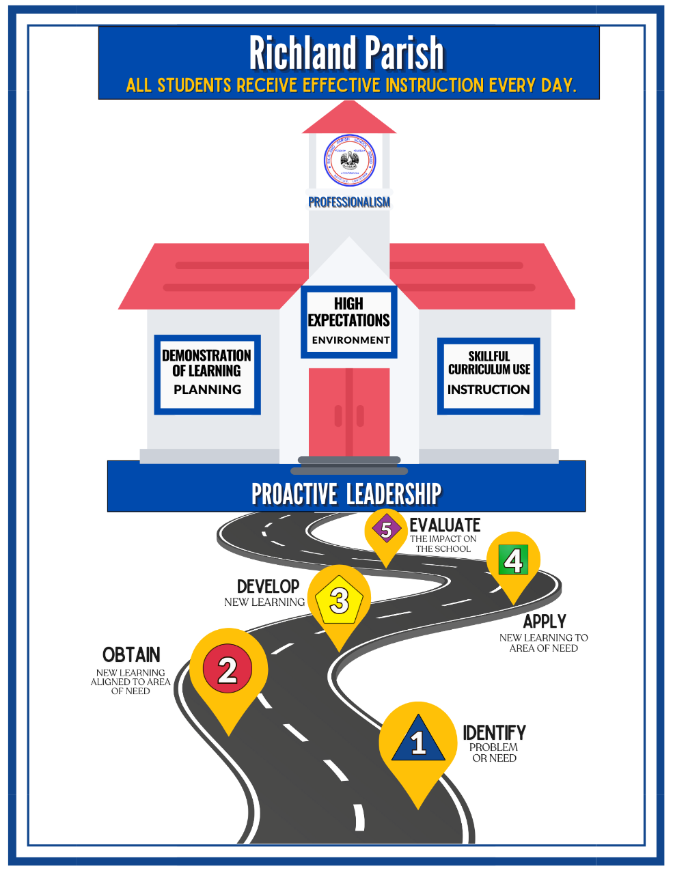
Richland Parish’s Framework for Effective Instruction Goals
Notes:
Have everyone look over the framework and share how this framework is coming to life at Start Elementary.

Slide 19
2023-2024 School Improvement Goals and Priorities
Given the data we collected at the end of the 23-24 school year, Start Elementary is focused on the following priorities.
All students, K-8, will receive effective instruction and consistent practice in math and ELA reading and writing.
By reaching this goal:
30 SES 4th through 8th grade students will move from achieving Approaching Basic to Basic on the LEAP test.
By May 2025, 58% of K-8 students will be on or above reading level, as measured by the EOY DIBELS Literacy Screener.

Slide 20
Working Together for School Improvement
We are committed to providing families with meaningful, two-way communication our plan and your child’s academic progress throughout the year.
Communicate with us:
Contact your child’s teacher with questions about your child’s progress, learning needs, or school events/programs through the weekly folder sent home by K-2 teachers, and 3rd-week progress reports for 3-8 teachers.
Download our School App

Slide 21
Working Together for School Improvement
We are committed to providing families with meaningful, two-way communication about our plan and your child’s academic progress throughout the year.
Support learning at home:
Join our family breakfasts to learn all about the curriculum and how best to provide support for learning at home.
Participate in our parent conferences to discuss your child’s progress individually towards meeting their learning goals.

Slide 22
Staying Connected
Office – located at entrance of school
School website- www.richland.k12.la.us/schools/ses/
Weekly Folders
Parent Teacher Conferences
Marquee Sign
Phone Messenger
Family Breakfasts
Start Elementary School Facebook page
School Information App

Slide 23
Student Handbook
Please review the Student Handbook found on our website under the School Information tab.
Our Student Handbook is also available on our school app

